Slide 1


Unit 2: Lesson 5 Was it really good luck?

Slide 2


Slide 3
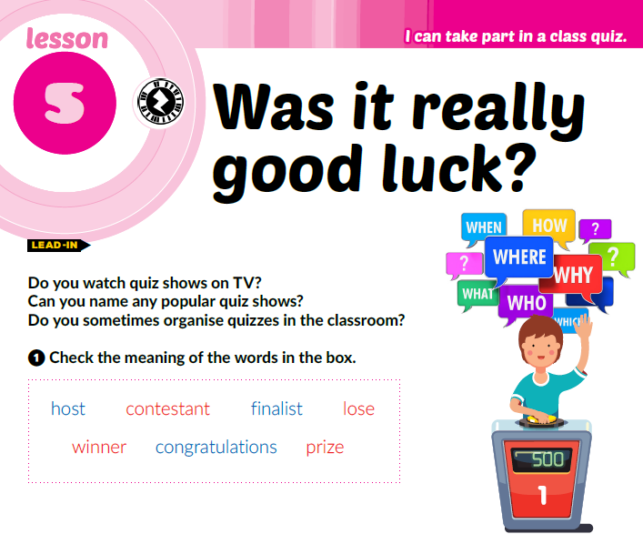

Slide 4
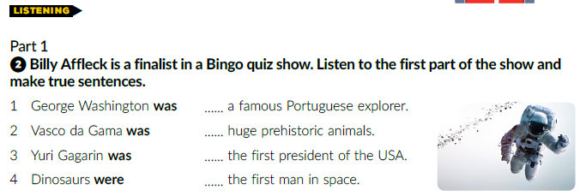
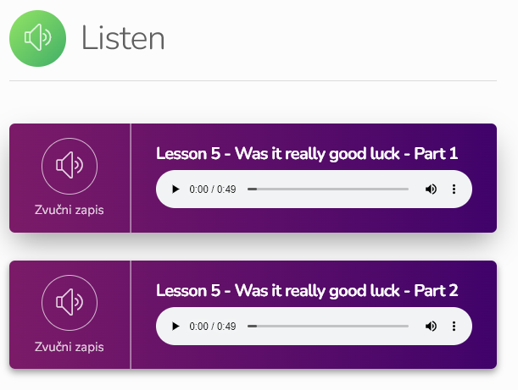
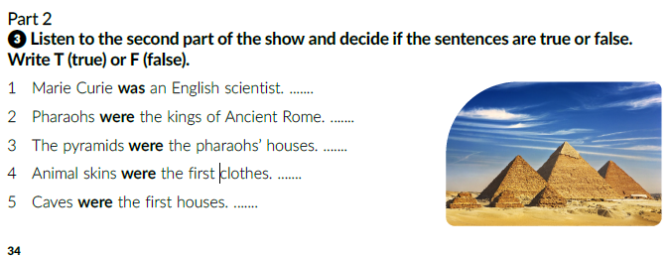
2
https://www.e-sfera.hr/dodatni-digitalni-sadrzaji/4dfc43d9-8f3a-4a13-9a1c-ced0be09dbab/
4
1
3
F
F
F
T
T

Slide 5
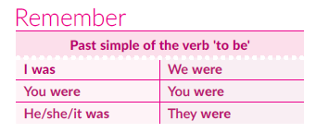
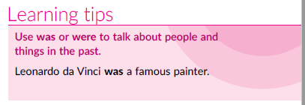

Slide 6
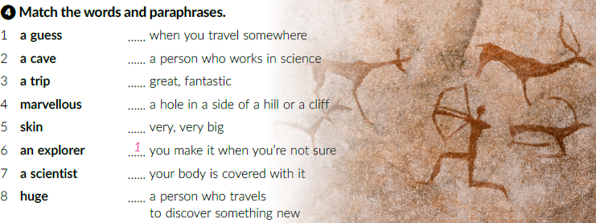
3
7
4
2
8
5
6

Slide 7
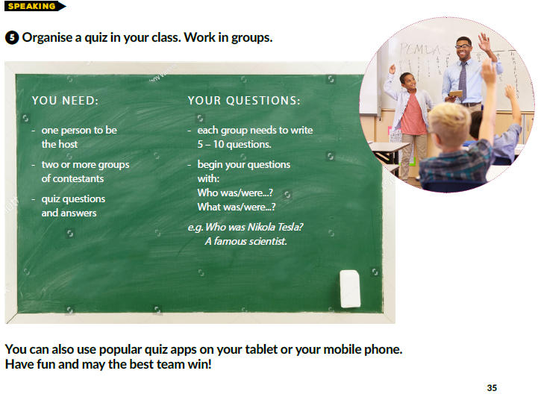

Slide 8
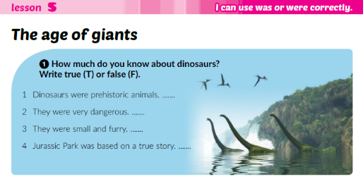
T
T
F
F

Slide 9
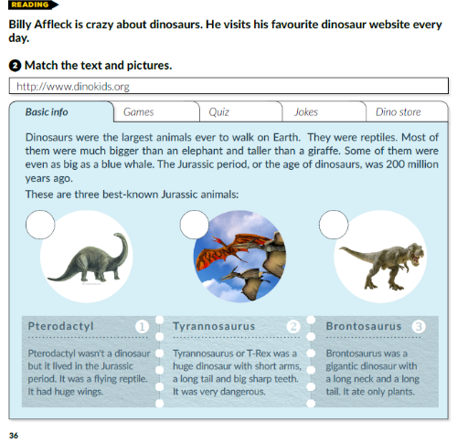
3
1
2

Slide 10
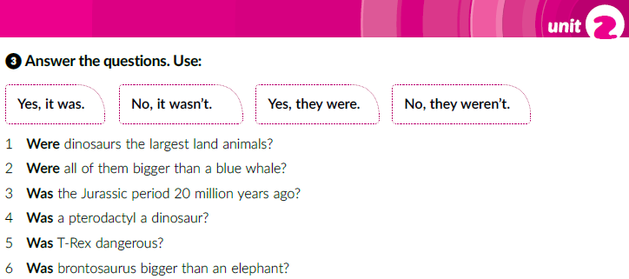
Yes, they were.
No, they weren’t.
No, it wasn’t.
No, it wasn’t.
Yes, it was.
Yes, it was.

Slide 11
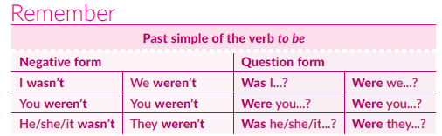
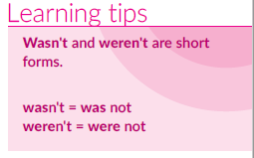

Slide 12
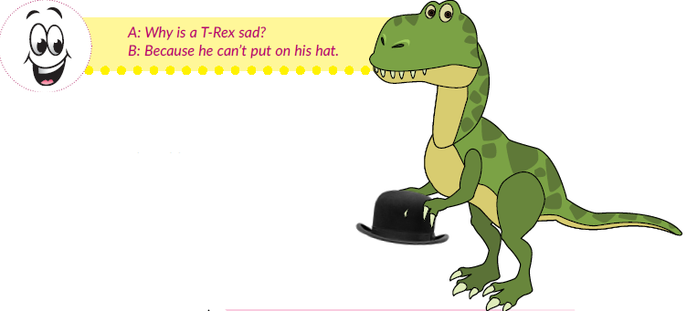
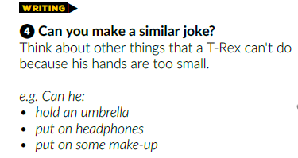
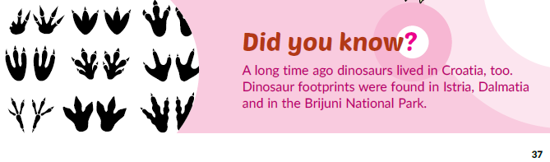

Slide 13
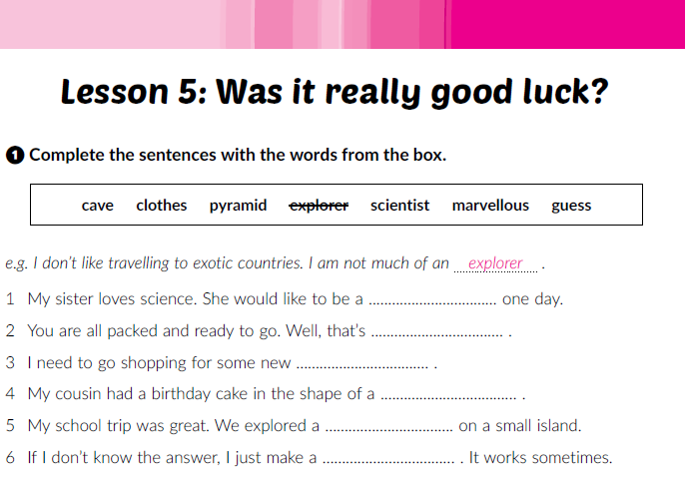
Workbook p. 24
scientist
marvelous
clothes
pyramid
cave
guess

Slide 14
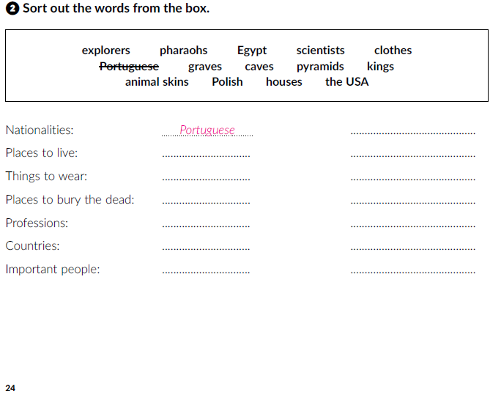
Polish
houses
caves
clothes
animal skins
graves
pyramids
explorers
scientists
Egypt
the USA
pharaos
kings

Slide 15
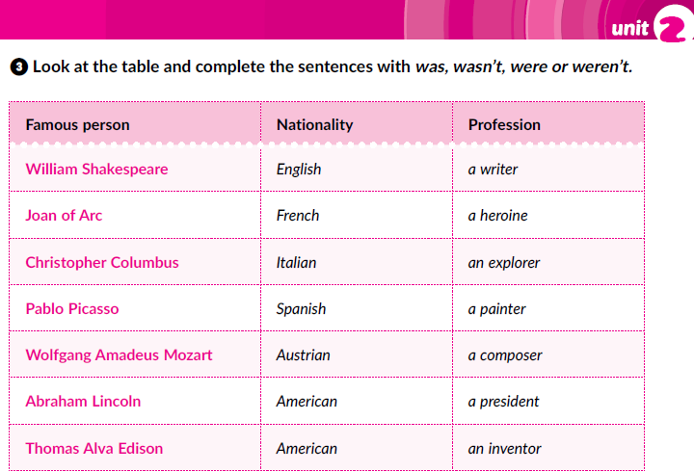
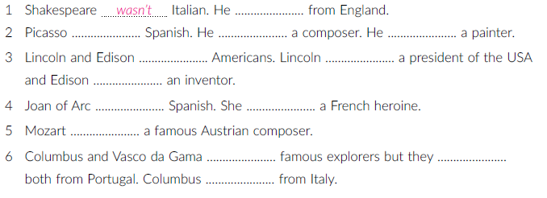
was
was
wasn’t
was
were
was
was
wasn’t
was
was
were
weren’t
was

Slide 16
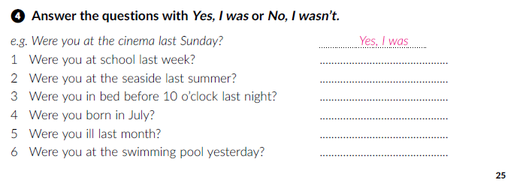

Slide 17
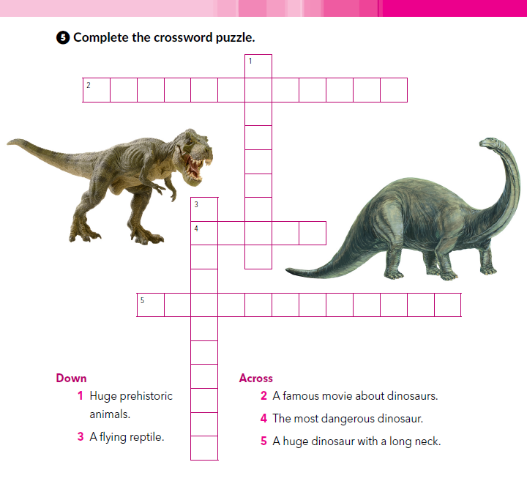
D
I
N
O
S
A
U
R
S
Y U R A S S C P A R K
P
T
E
R
O
D
A
C
T
Y
L
B R N T O S A U R U S

Slide 18
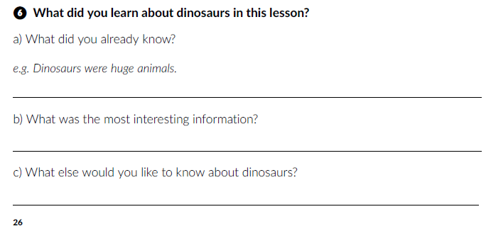

Slide 19

PLAY AND LEARN
https://www.e-sfera.hr/dodatni-digitalni-sadrzaji/4dfc43d9-8f3a-4a13-9a1c-ced0be09dbab/

